Slide 1
Everybody, Somebody, Anybody, or Nobody? Colorado’s Development of a Statewide Access & Functional Needs Program
Aimee Voth Siebert, Charlotte Olsen & Sadie Martinez

Slide 2
You’re Here...
Photo Credit Canva.com
Notes:
We want to start here at the beginning of our presentation to acknowledge that the environment we are all living in is not the usual. We are all in some way affected by this public health emergency in our communities. Collectively and individually, because of how this disaster is affecting us and other challenges in our lives, we are probably bringing more stress and emotions into this conference space. We will be talking about the barriers people experience to accessing what they need during disasters, and you may be whispering to yourself “Hey, I’m feeling that.” You may be experiencing exhaustion, overwhelm, isolation, or loneliness that makes it hard to engage the conference content.
You’re not alone in these feelings. These are very common reactions to a difficult, abnormal event. Let us be one more voice to encourage each other and emphasize that we are most helpful to others when we are also taking care of ourselves and including that as part of how we do our jobs well. You matter.
To honor that you have taken the time to view this presentation, we invite you to prepare your bodies and brain to be present and to put yourself in a space where you can get the most out of it.
I invite you to come to a comfortable sitting or standing position and just give yourself permission to breathe…and to do nothing else. Inhale…Exhale…Repeat. Feel free to take it at your own pace. Continue breathing normally if that works best for you. If you would like to learn the research-based relaxing breath breathing pattern, start to count at a comfortable pace. Breath in for 4 counts (1…2…3…4…) keeping the air filling your lungs. Then hold that breath for 7 (1….7…). Finish by breathing out slowly for 8 counts (1….8…) release all of the air from the bottom of your lungs. Speed up or slow down to match what suits your lung capacity, but keep it steady so that the ratio of time for inhaling, holding your breath, and exhaling stays balanced 4…7…8…
Feel free to pause your presentation to do several cycles and to feel how that changes your body experience.
We also want to invite you to give your brain a chance to be present in this presentation. If your brain came to this presentation preoccupied or attending to something else, we invite you to find something to write on and take a moment to write down what is on your mind. Write down a reminder or important details that will allow you to return to it after the presentation without concerns. But let this note be your container, so that your brain can let these things go without worrying, and you make space to hold new ideas and information that rise as you engage the conference. Feel free to pause the presentation again while you do this for 2 or 3 minutes. You deserve the best learning environment possible

Slide 3
Quote
“There was an important job to be done and Everybody was sure that Somebody would do it. Anybody could have done it, but Nobody did it. Somebody got angry about that, because it was Everybody’s job. Everybody thought Anybody could do it, but Nobody realized that Everybody wouldn’t do it. It ended up that Everybody blamed Somebody when Nobody did what Anybody could have done." - unknown author
Photos Credit Canva.com
Notes:
Aimee
I want to start with a story that you can read along with on the slide. It’s a little unclear where this “Parable of Responsibility” came from, but as we think about fault lines in emergency systems, especially in the domain of integrating access & functional needs, maybe it will resonate with you.
[story]
No matter what our job is in emergencies, all emergency preparedness and response roles exist to protect and minimize a disaster’s disruption to the lives of people in our community. We don’t respond to hurricanes over open ocean, or restore power after a tornado to places where people don’t live. At the center of any disaster is the community surviving it. Therefore, our systems must be alert and responsive to the diversity of people’s lived experiences and needs.

Slide 4
When have you learned something about community needs from another emergency support function or partner?
Notes:
No single responder or even response agency can be in all places at once. Information gathering about our community’s needs and experiences must be an essential element of information that everybody supports. To help explain why, consider this question: “When have you learned something about community needs from another emergency support function or partner that affected the operations or outcomes of your emergency role?” We expect you have examples from your work; here are a couple from ours:
Aimee: Two years ago, we were holding an Ebola Special Pathogens exercise. What stood out to me was how much I depended on others for situational awareness. The EMS folks were the only ones who got to interact with airplane pilot and copilot. This was actually an inject for behavioral health supports because the people who had transported people with suspected Ebola were feeling scared by this experience. The EMS, medical transport staff were obviously focused on the patients, but behavioral health responders were not called or onsite. So recognizing that behavioral health need relied on those who had access to this space. Similarly, another patient presented at an urgent care clinic and came from a non-English speaking community. That clinic was able to leverage language services to provide patient care, but the communication need did not get shared with epis doing contact tracing or public information officers providing messaging, which if the outbreak grew would be important very quickly. The effectiveness of some of these public health response actions depended on knowledge of community functioning and needs, which could only be shared by other emergency partners.
Charlotte: Q’an’jobal - the meaning of “positive” when it comes testing:During the first months of the COVID response here in Colorado we noticed that there were communities across the state that despite all the knowledge that was out in the community around COVID and the necessary precautions, cases were rising. We found this especially in a farming community in the San Luis valley in a community from Guatemala that speaks a dialect called Q’an’jobal, which is a largely unwritten dialect,. In order to provide outreach to this community, There was a promotora group that sprung up in the region with trusted community partners and when they were doing community outreach they discovered that this community had misunderstood the meaning of a positive COVID test. They thought positive was a good thing and weren’t aware they needed to take precautions to protect their families which led to adverse effects across their communities. Once we were able to overcome the language and cultural barriers through the help of promotoras, we were able to support this community in a way that they wanted to be supported, and provide them with essential information and resources to help protect themselves.

Slide 5
Access & Functional Needs
Communication
Maintain Health
Independence
Safety, Support Services, Self-Determination
Transportation
Discussion
How are your response services reliant on community functioning in these areas?
How do you support community functioning in these areas?
HHS Access & Functional Needs Web-Based Training
Notes:
In all disasters, and especially as we are feeling in this active public health emergency, the success of an emergency response is affected by the functioning and cooperation of community members.
“Access and Functional Needs” is a phrase and a concept being adopted in emergency management closer to look more closely at what affects different community’s functioning during disasters and helps promote planning and response that is inclusive of diverse community experiences. Instead of just labeling “vulnerable populations” or asking “WHO is vulnerable?” the access and functional needs approach recognizes that everyone, regardless of who we are, needs to be able to communicate, maintain their health, retain their independence, access safety, supports, services, that allow for self-determination, and transport (or move) themselves. Those 5 areas make up the CMIST framework from June Kailes and Alexandra Enders that you see listed on this slide.
Though everyone shares these 5 access & functional needs, our emergency systems have not resourced different communities in meeting these needs equitably. Everyone needs to be able to communicate and receive information, but you can imagine our emergency responses have not resourced non-English speaking communities, or native American Sign Language users at the same level as English speaking communities.
When it comes to accessing emergency resources, like shelters, vaccinations, or disease testing, there may be a transportation barrier for those who don’t have access to a vehicle in their household – unless the response is building these community access and functional needs into their planning.
As you may already see, access & functional needs is different than simply people who are “at-risk” to the hazard or its characteristics. For example, people with chronic lung conditions may have greater impact due to smoke during a wildfire or risk for serious illness during COVID-19, but access & functional needs encompasses barriers and concerns in much broader community groups. Access & Functional Needs demonstrate a gap between how communities communicate, maintain their health, etc. on a day to day basis, and what emergency systems have factored into their disaster planning and operations.
But disaster operations and community functioning are interdependent! We invite you to consider the questions on this slide. How does the success of your response operations rely on community functioning in these areas? (i.e. does someone’s access to phone service or internet in their homes affect what communication they would receive about disaster notifications or resources you provide? What if someone has naturally elevated body temperatures, like a person who is paraplegic often does, and there is a fever check in order to access certain services?) And how do you support community functioning in these CMIST areas? Does you agency have a role in keeping people safe, and how does that role adapt in disaster environments?
These gaps between how community groups meet their CMIST needs and what considerations are integrated in disaster planning is a huge reason in why we see the same stories about disparities in exposure, injury and death after so many different disasters. We also recognize that disasters don’t happen in a vacuum and these 5 CMIST areas interact significantly with community power dynamics and social determinants of health, including trust, economics, isolation, capacity, housing, and racism.

Slide 6
ESF’s
ESF 8
ESF 5
ESF 6
Notes:
Engaging the concept of access & functional needs really elevates the need for people-centered, whole community emergency planning. Charlotte, Sadie, and I all work for the state of Colorado, but we each come from different departments, different disciplines and different emergency support functions as defined by the national response framework. If you look at this slide, you see how Health and Medical, Emergency Management, and Mass Care each handle their own domains and emergency tasks and we only overlap in small spaces.
ESF-8
In Colorado, our ESF-8 Health and Medical responsibilities are housed under the Colorado Department of Public Health and Environment at the state level. We are a separate department from Human Services, which is different than the federal level. There’s also variety among our county level partners.
When it comes to access & functional needs, public health brings some good assets in their science basis, access to data, and the cultural drive around health equity and environmental justice. For a long time we have recognized disparities in health outcomes, and we can add that long-term data storytelling and program engagement with community groups to conversations with other disciplines about barriers, but also behavioral strengths, that communities might bring to the table.
Our key partners that run from prevention through recovery in the health world, including hospitals, emergency medical services, long-term care, home health, coroners, behavioral health and community organizations of many types.
Worth noting, ESF-8 has been funded (if under-funded) for intentional planning and preparedness efforts for over ten years, and that has created some consistency. We have watched the emergency culture shift from vulnerable populations language to a greater adoption of access & functional needs and we have built that into grant activities with local and state health & medical partners.
ESF-6: At the Colorado Dept of Human Services, we are responsible for the coordination of ESF#6 at the State level- this is Mass Care (so feeding and sheltering) Emergency Assistance, housing, and human services. For the covid response I say “the non public health, human part of disasters”
We are here to support people and make sure their basic needs are met and activities of daily living are able to continue in some way, though they might be different for each disaster. This might mean coordinating sheltering, helping childcare facilities to stay open, providing food or money to people who have been displaced, working through recovery or housing issues, or a variety of other issues that arise.
We work closely with state and local voluntary agencies, local human services agencies, and are largely unfunded to do all this work.
ESF-5: We look at the Whole Community Inclusion for coordinating but are not the lead we support with logistics and resources in all the Community Lifelines, Safety & Security partners and ESFs Food, Water & Sheltering, Health & Medical, Energy (Power & Fuel), Communications, Transportation, & Hazardous Materials we are funded by Homeland Security Preparedness Grant & Emergency Management Preparedness Grants
Aimee:
As you can probably tell, we have to rely on each other and our respective ESF networks to think about community access & functional needs in our respective spaces. I, Aimee, rely on other colleagues in the Health and Medical work to be thinking about access & functional needs where they’re doing work. None of us can be everywhere at once, but all emergency work ties back to this overarching goal to help our communities through the disruptions caused by the disaster.
It was out of this growing recognition of our interdependence, and due to a good push from the Colorado community, that Colorado has adopted and begun to develop a statewide Access & Functional Needs Program. Over to you, Sadie!

Slide 7
Colorado’s Access & Functional Needs Program
Notes:
Sadie

Slide 8
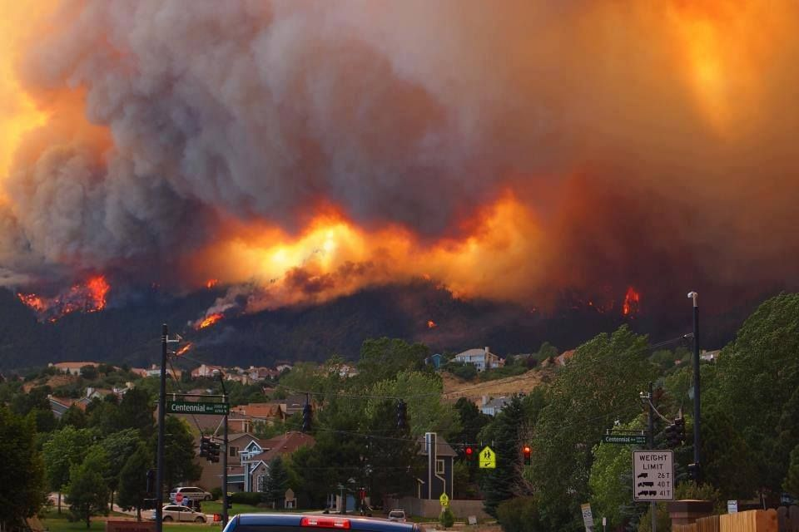
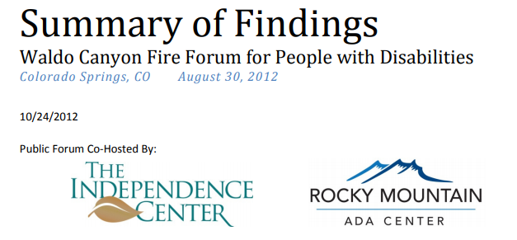
History
Notes:
Sadie
Waldo Canyon and the Summary of Findings: Waldo Canyon Fire Forum for People with Disabilities Colorado Springs, CO August 30, 2012 in 2013 The Independence Center hired an Emergency Program Coordinator for Disability Inclusion in Emergency Management
2017
The Indepence Center gained Statewide Stakeholder engagement to support Joint Budget Committee request for funds to be designated to build a statewide network of community based disability integration emergency planners (DIEP) (AKA Access & Functional Needs)
2018
JBC approved the budget for $500K for Legislative Requests for Information FY 2018-19 Governor focusing on the these areas:
Structure and Network (funding)
Developed a report to capture inclusivity of people with access and functional needs on information sharing, training and exercise planning in the Emergency Management lifecycle.
Planning, recommendations for a network of contracted regional/local Access and Functional Needs Planners and expected deliverables for community-based contracts.
Person centered planning (preparedness) and training/exercises to include documentation
Evaluate Colorado’s ongoing work to integrate access and functional needs and people with disabilities into the emergency management cycle.
Identify participation of people with disabilities in planning, training and exercising to be a key indicator of that integration.
Identify the number of individuals with a wide variety of disabilities that are included in Discussion-Based Exercises and Operations-Based Exercises at the local, regional, and state level.
Identify the number of people with disabilities and access and functional needs who participate in creating their individual emergency plans or emergency preparedness workshops.
Identify inclusive planning efforts at the state level across divisions and departments including Department of Public Health and Environment that now include people with disabilities and access and functional needs.
Homeland Security Advisory Council Created an Access & Functional Needs Subcommittee
Hired Access & Functional Needs Coordinator November 2018
Some of the things we started with were the AFN workshops and conferences that helped gather a snapshot
Gathered feedback from 9 all-hazards regions Access & Functional Needs Whole community workshops (12 Total) Link to data captured AFN workshop Responses & Questions with collaboration of
Developing Shared Language across ESFs: CMIST CMIST Resource List
Sent out RFP for 2 All-HAzards region Whole Community Inclusion Planners
1st Access & Functional Needs Conference: Getting it Right in Colorado Communication Access and Functional Needs Conference

Slide 9
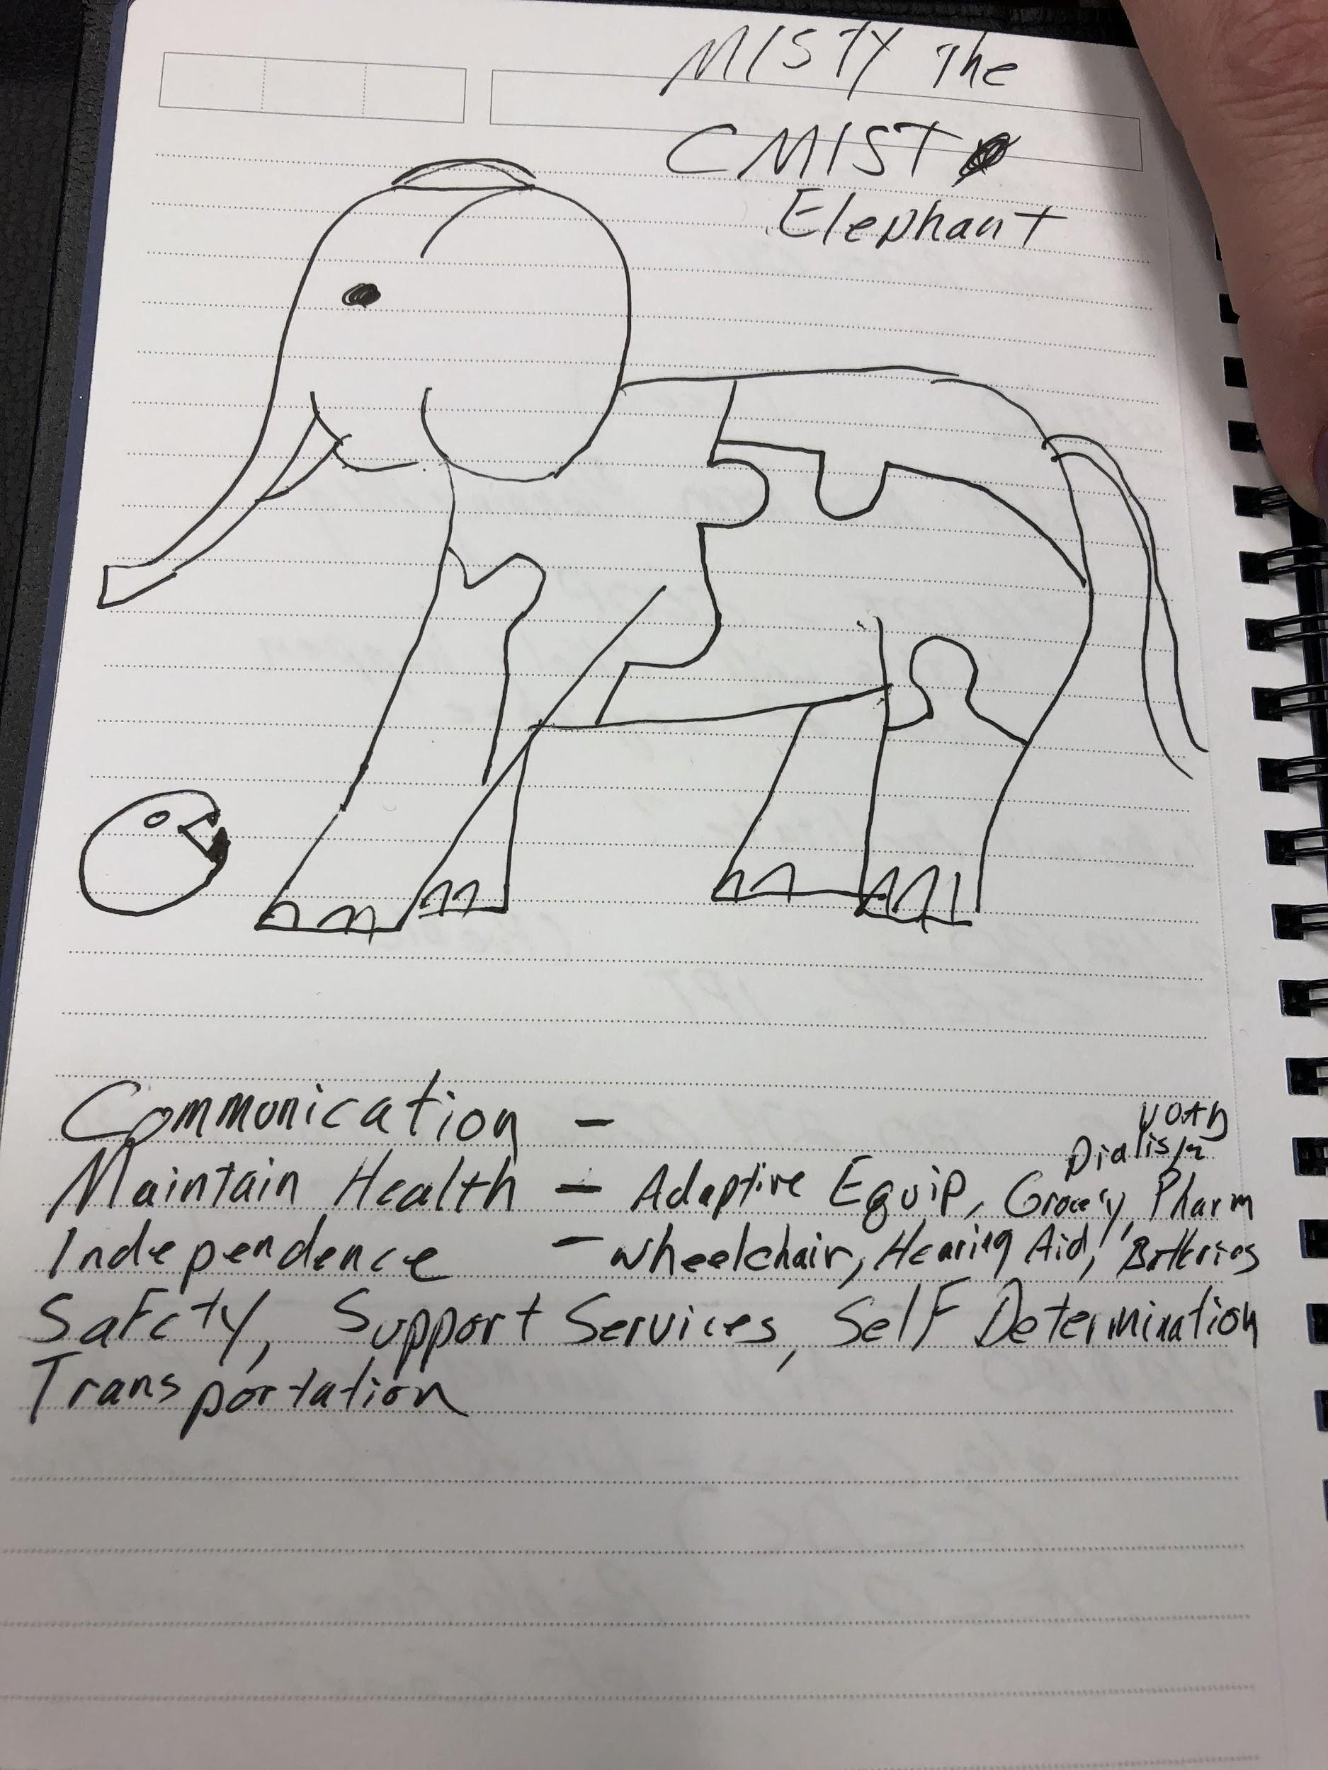
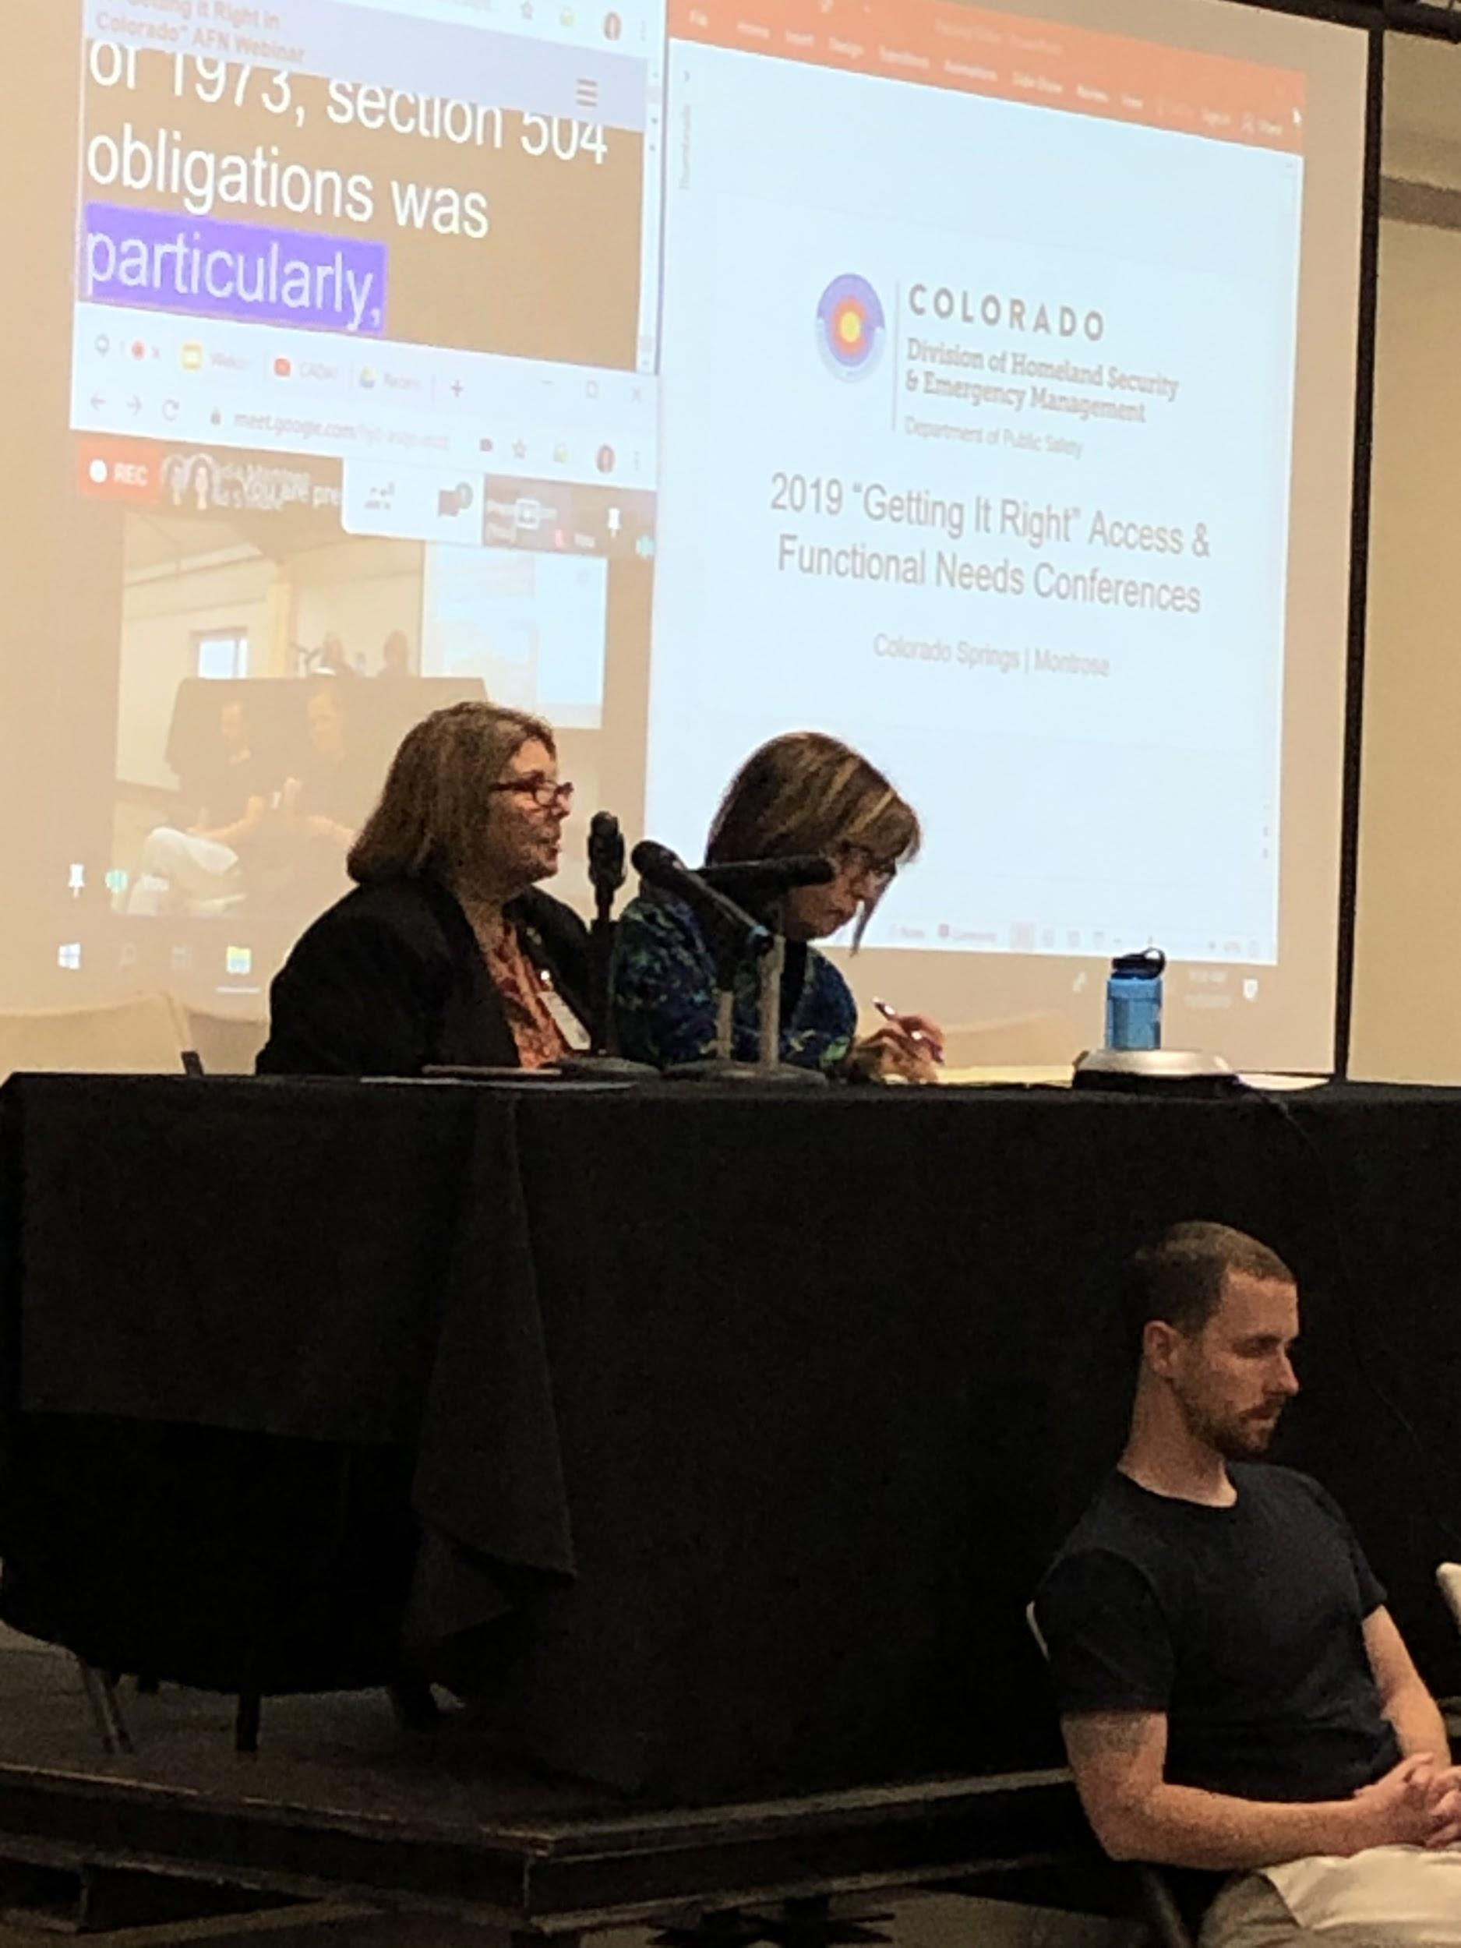
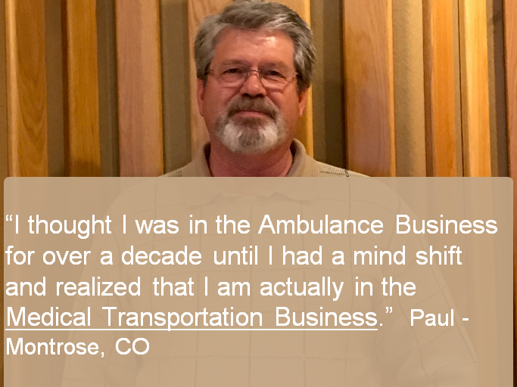
2019 Taking a Snapshot and Developing Shared Language
Regional Access & Functional Needs Workshops
Colorado’s Getting It Right Conferences
Notes:
Sadie: ambulance driver part of CMIST transportation story. (Sadie)ESF-5 Language tends to be around resource and in
CMIST Elephant
(Aimee) These workshops really helped us realize that our different cultures, which we mentioned before, almost had their own languages. Public health really was leaning on equity language; some of our local partners even had “equity in emergency preparedness” committees where they were applying the CMIST and access & functional needs ideas into non-PHEP, non HPP projects. Bringing public health and human service and emergency management and community based organizations into the same place helped us make a shared language, an Access and Functional Needs “Esperanto” that helped us recognize each others’ skills and opportunities.
During the 2019 Getting it Right conferences, it was really powerful to have presenters from different backgrounds, speaking these different disciplinary languages and then starting to absorb vocabulary from each other. That middle picture was such a great ‘ah ha’ moment, when an EMS partner clicked in with how they fit into the CMIST framework.
Another metaphor I’m fond of is the idea of a social fabric. Each of our threads alone would easily snap, but when we start to overlap and reinforce each other, we get far more coverage and we’re far less likely to fray under the stress of a disaster. Our greatest strength comes from weaving into the natural fabric in community connections so that each of our agencies becomes more familiar and communities start to feel smoother collaboration and hand offs across different needs that cross-cut our traditional service areas.
Colorado has good bones, how do we put some muscles and sinews on this program so we can get up and move around and see where this program goes.
(Charlotte) What was really great about these workshops was an opportunity for ESF6, ESF5, ESF 8 and local community partners to come into the room for the 1st time or 1st time in a long time around emergency management -many times human services partners are left out of planning conversations- and it was great to see them share how they can provide support to the people in their community during blue skies and during emergencies. It was so nice to see partners from across a county and region come to sit at the same table and realize the resources that they can provide to support their own citizens during a response that they didn’t know about before. We all know that emergency management is largely built on relationships and trust and these workshops allowed partners to begin to build those relationships and we are seeing these relationships grow and lifelines to support people during the COVID response if that is one thing to come out of this.

Slide 10
2020 – Building Capa…COVID-19
Continued Shared Language Building
Regional Access & Functional Needs Subcommittees
Training about Access & Functional Needs in EOC
Response Training: CMIST Response Teams Training Curriculum with areas of concentration:
On-Site Environmental Accessibility Assessments
Functional Needs Assessments
Information and Technical Assistance Support
Community Outreach
Emergency Response Interpreter (Languages)
Future Consideration: Media Communications Response Teams
Notes:
Intending to do in 2020 was ^^
COVID
Planning
R&R state level cross agency and nationally focus
Planning and coordination of a program and its activities.
Develop and monitor procedures, guidance, and policies for the AFN program
Managing, coordinating and overseeing of planning
Develop a budget as well as criteria for CMIST resources identified in each CEPA plans in each Emergency management jurisdiction.
Create guidance and rules for Scholarships to attend National conferences for more training.
Information Sharing
Maintaining budget and tracking expenditures/transactions.
Implementing, marketing and evaluating program projects
Develop an Emergency Response Interpreter training for top 5 Colorado Languages as well as ASL.
Create local a program to identify AFN support for the EOC’s before, during, and after emergencies and disasters.
Create guidance and toolkit for implementation for AFN Subcommittee for each 10 RFS all-Hazards Region with funding for travel and Per Diem for participating
Community Connector Emergency Preparedness Contract Support
DHSEM Website accessibility Fix-up
Translation and ASL Videos with Voice and Caption for Website resources
Training
Create AFN Focused Exercise program:
Drills
Functional
Full Scale
Create an AFN Emergency Management Training program
Basic level
Intermediate level
Advanced level
Create AFN Training Tract
CMIST focused
Create Criteria, materials, agenda for Annual AFN Conference
Create Training program for each 10 RFS all-Hazards Region quarterly AFN training
Create CMIST Response Teams training program

Slide 11
Fixing the Fault Lines: Challenges and
Accomplishments
Notes:
There is huge irony to me that in the year 2020, my hindsight does not feel “2020” crystal clear. There were a lot of efforts we planned to continue, innovations we wanted to explore…and then COVID-19 brought the most profound object lesson in several generations of emergencies. Hard as COVID-19 has been, if we can hold onto the lessons we’ve been learning, we have an extraordinary opportunity to get buy in and shape this program to be a true whole community approach to access & functional needs. Because this is a job that has truly needed everybody to try to keep up.

Slide 12
COVID-19: “Everyone has a plan until they get punched in the mouth”
ESF 8
ESF 5
ESF 6
Notes:
We know how much better we off we are having laid some of this program’s foundations over the past two years, but COVID-19 has also made us realize how much ground can still be left uncovered. It cannot be one ESF. It cannot even be a coordinator within each ESF. It has to be everyone.
ESF-6 We normally coordinate with the Red Cross, disaster feeding organizations like the Salvation army and southern baptists and local human services agencies
COVID has expanded our partnerships 20 fold. normal disaster one or two counties- We spent the first couple months just trying to wrap our heads around who these new partners are and how to bring these new partners to the table that knew next to nothing about emergency management or weren’t familiar with local partners and helping to break down barriers to help locals coordinate more efficiently.
ESF-6- now incorporates a homeless task force and we are running the non-congregate sheltering program across Colorado. We are supporting food banks and food pantries with food shortages and have ordered 400,000 worth of shelf stable foods for distribution to those who are high risk or in isolation and quarantine . We ordered 3 million dollars worth of diapers formula and wipes for family resource centers and low income families across the State and gotten over 800,000 to start a statewide promotora network that focuses on farms and food systems, and it has been trial and error the entire way. There was no plan for any of this.
ESF#6- From an ESF#6 perspective the main challenges are a lack of funding and lack of resources and personnel. We have been operating as a two-man team for the entire state for past 6 months. I have learned how to spend other agencies money for resources and support and to bring large diverse groups together to create solutions to complex issues, but the burnout is real, and the need for additional support is clear.
ESF 5
Translating for community partners, for EMs - everyone, especially ESF-5.
AFN is not just a label or an annex “Vulnerable People” change language to those at higher risk of getting COVID
PPE Allocation Task Forces- BH, ACF/S, ACS Training, Accessible resources for people getting COVID, Testing sites, Agriculture, guidances, press conferences,
~ spread thin I needed help and it came with a resource request of a person who ended up supporting a training development research to not miss anything through this event

Slide 13
Challenges
Capacity
Funding
Grant-driven activities
Colorado’s Department Structure
Authority differences
Notes:
ESF-8
As much as the PHEP and HPP grants have helped us keep up the Access & Functional Needs conversation among public health partners, I don’t think any of us realized how comprehensively overwhelmed public health and health care staff would be by a pandemic incident. This disaster bulls-eyed us dead on and scattered us to the winds with critical tasks: surveillance, testing, data modeling, policy making, lab work, guidance development, contact tracing, environmental assessment, messaging, healthcare and treatment, moving medical materials, planning for alternate care facilities, vaccine distribution, crisis standards of care, a human resource hiring frenzy…many of you know I could keep going. We were spread thin as butterfly-wings, and nowhere more strongly pulled than small, half-dozen staff, public health departments. Disappointingly, these same public servants are also feeling the added strain of local officials and community members coming at them, not with support, but criticism, even threats.
I think Colorado is also realizing how departmental structures add another layer of complexity. The Department of Health Care Policy and Finance runs Medicaid in Colorado and is 20x larger than the public health department. But with CDPHE as the designated state agency for health and medical disaster concerns, it has been eye-opening to realize how much health work is done by other agencies, and how many assets we could build stronger relationships with in state government alone.
As the grant year came and went in June, our local public health partners gave us brief updates on the activities that had been part of their contracts this year. Many of the activities originally approached as planning and preparedness came to full response life, but I also heard clearly from many of them that “we can’t do everything” and access & functional needs were touching everything. Addressing these needs are critical to the success of the public health response, but public health was in too high demand to be able to manage all of the resource needs that would arise. We had to lean on the other partners doing powerful work in addressing access & functional needs.

Slide 14
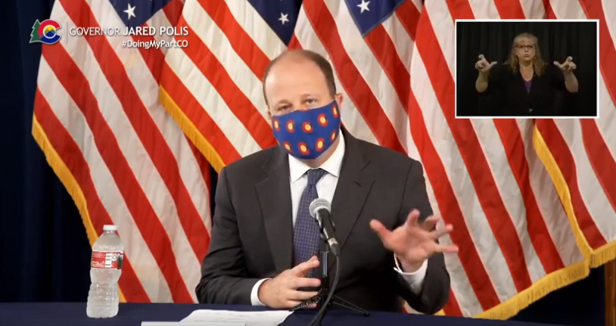
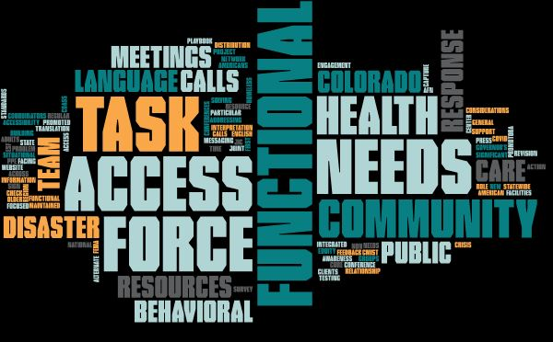
Accomplishments
Notes:
Roles
Expanded networks, collaborations
Feedback
Practices and Resources
First time to have an access & functional needs role in the Joint Information Center
maintained significant non-English language translation across public messaging,
integrated American sign language interpretation in the Governor’s press conferences,
promoted website accessibility with support from community feedback
public facing resources addressing Access & Functional Needs in general and in particular community groups.
Regular situational awareness and resource problem solving meetings
Colorado CMIST Access & Functional Needs Conference Calls
FEMA Region 8 and Colorado calls
National and State AFN Calls
Behavioral Health Disaster Coordinators’ meetings
Disaster Behavioral Health Task Force
Homeless Task Force
ESF-6 Task Force
New Americans Task Force
Health Equity Response Team and JIC Check-in
COVID-19 and Older Adults Response Team
Access & Functional Needs focused resources, relationship building
Statewide Promotora Network
Project Cure PPE distribution to CDASS clients
Access & Functional Needs Considerations in Testing Playbook, Alternate Care Facilities
Community Engagement in Crisis Standards of Care revision
A “During Action” survey to capture lessons learned, accomplishments, and ongoing concerns for future waves and events.

Slide 15
Access & Functional Needs demand a whole community approach – everybody trained, anybody can speak up, and somebody focused
Community-centered and system-flexible – CMIST framework as a “Watch out” structure
Integrating non-traditional partners
Government leaders
Social service non-profits
Cultural navigators
Everyone is a responder, but not everyone is resourced like one
Notes:
It takes everybody, because in a public health disaster, people touch everything. Community members have to understand themselves as both disease vector and disaster responder because their behaviors will determine if the disease spreads or is contained. People are public health infrastructure; they are the contact tracers, the lab techs, the data analysts, the in-home care, the truck drivers, the healthcare workers. And burn out threatens this response capacity over a sustained response if we don’t recognize that these aren’t widgets, they’re people. People worried about their loved ones, strained by long hours, exhausted by screen time. We have access & functional needs too.
So access & functional needs demands a whole community approach. We need the depth where everybody is trained to use a CMIST lens, where anybody can speak up if they see something, but where there’s also more intention to always have somebody focused on community needs within the current discussion.
We need an emergency system can flex with where these community needs come up and are addressed. Wouldn’t it be wonderful if CMIST was among our essential elements of information, included in all situation reports and AARs, a “watch out” for everyone?
If COVID-19 taught us nothing else, it’s that our whole community is going to show up. Government leaders will assume roles and responsibilities that may not have been spelled out quite that way in our emergency plans. We will need the business and non-profit community assets, social services not previously included in our organizational charts. We will need the skills, relationships and community knowledge of a wide range of cultural navigators to surmount pre-disaster barriers of trust, education, and isolation. We will need to have a long talk about how we resource this, because when everyone is a responder, it is very telling who gets to be resourced like one. It isn’t always tied to their value in achieving emergency objectives.
How to deliver resources to groups vs. resources to individuals living independently, not grouped
How we reach people multiway feedback model
Move logistically and administrative in Emergency Management
ESF 6 - Food insecurity Formula and diapers
Relationships that are already in place and how we can overlap in ESF-s
Distribution models CEPA/THIRA/HVA/HIRA/SPR- Congregate care facility vs Congregate sheltering in COVID

Slide 16
Whole Community inclusion Concept
People
Responsive, Effective, Inclusive Response and Planning
Hazards
Infrastructure
Notes:
We need to remember that the community experience is at the heart of why our emergency systems exist in the first place. It’s not for the hurricanes over open water. It’s not for infrastructure in a ghost town. These things matter only in the context of their impact and value to people’s lives. Colorado’s Access and Functional Needs Program aims to regularly center and elevate the people-centered experience of disasters for our planning and response. It’s a long road, but we’re excited to share and learn at this point in the journey.

Slide 17
Contact Us!
Charlotte Olsen
Regional Emergency Management Specialist (REMS) for the
Administration for Children
& Families (ACF) under
Health & Human Services
in Region 8
Charlotte.Olsen@acf.hhs.gov
Aimee Voth-Siebert
Behavioral Health and
Inclusion Worklead
CDPHE-OEPR
303.692.2686
aimee.vothsiebert@state.co.us
Sadie Martinez
Access & Functional Needs Coordinator
DHSEM
720.610.1691
sadie.martinez@state.co.us
Notes:
Thanks for listening! We hope you take a moment here at the end to let settle what you want to take away. We invite you to make note of 1 partner to connect with, and 1 strategy or task you would like to complete in considering access & functional needs in your own programs and communities. Do you have a question or maybe insight or a story you’d like to share with us? Please use the contact information above to reach out to any of us. And thank you for all of the ways you support your communities in this time. All of us are a puzzle piece that contributes to the whole; we leave a gap in our absence. Please take care of yourself as an important part of continuing your good work!

